Slide 1

GROUP 2 4SC1
M HUDYA R MUTIA A D
DIGITAL WATERMARKING

Slide 2
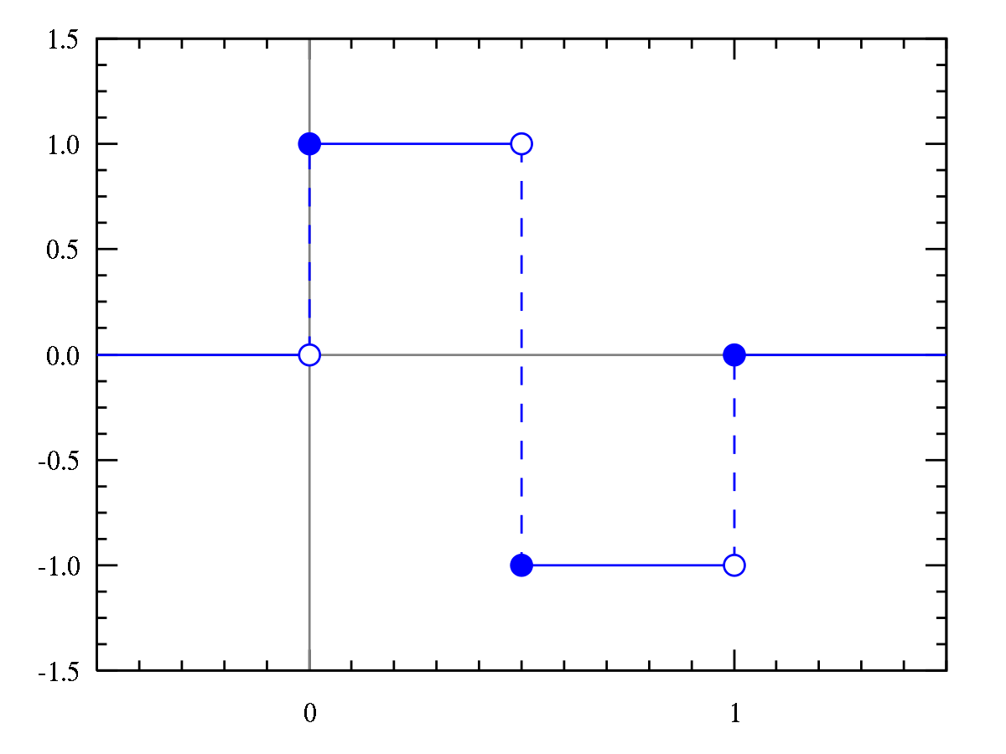
A
B
S
T
R
A
C
T
Notes:
Mutia

Slide 3
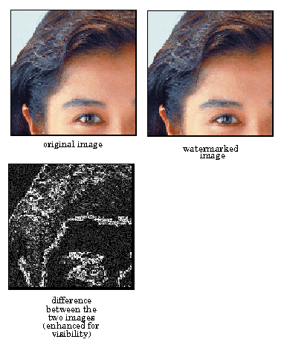
INTRODUCTION
Notes:
KIDDY

Slide 4
M
E
T
H
O
D
O
L
O
G
Y
Notes:
Kiddy

Slide 5
M
E
T
H
O
D
O
L
O
G
Y
Y
N
Notes:
mutia

Slide 6
RESULT
Notes:
Kiddy

Slide 7
CONCLUSION
AND
SUGGESTION
Notes:
Mutia

